Slide 1

UNI-Demands: A MERN-Based Multi-Vendor Platform
Submitted To:-
Ms. Mehak Kohli
Assistant Professor CSE
Submitted By:-
Amrik Singh
12200252

Slide 2




The Campus Commerce Conundrum
Disjointed Transactions
Lack of Centralization
Students and campus vendors face significant hurdles in buying and selling products and services within the university community.
There is no dedicated, centralized platform for the campus community, leading to inefficient exchanges and missed opportunities.
Manual & Insecure
Current methods often involve manual payments, which lack security, and an absence of robust authentication for users.

Slide 3
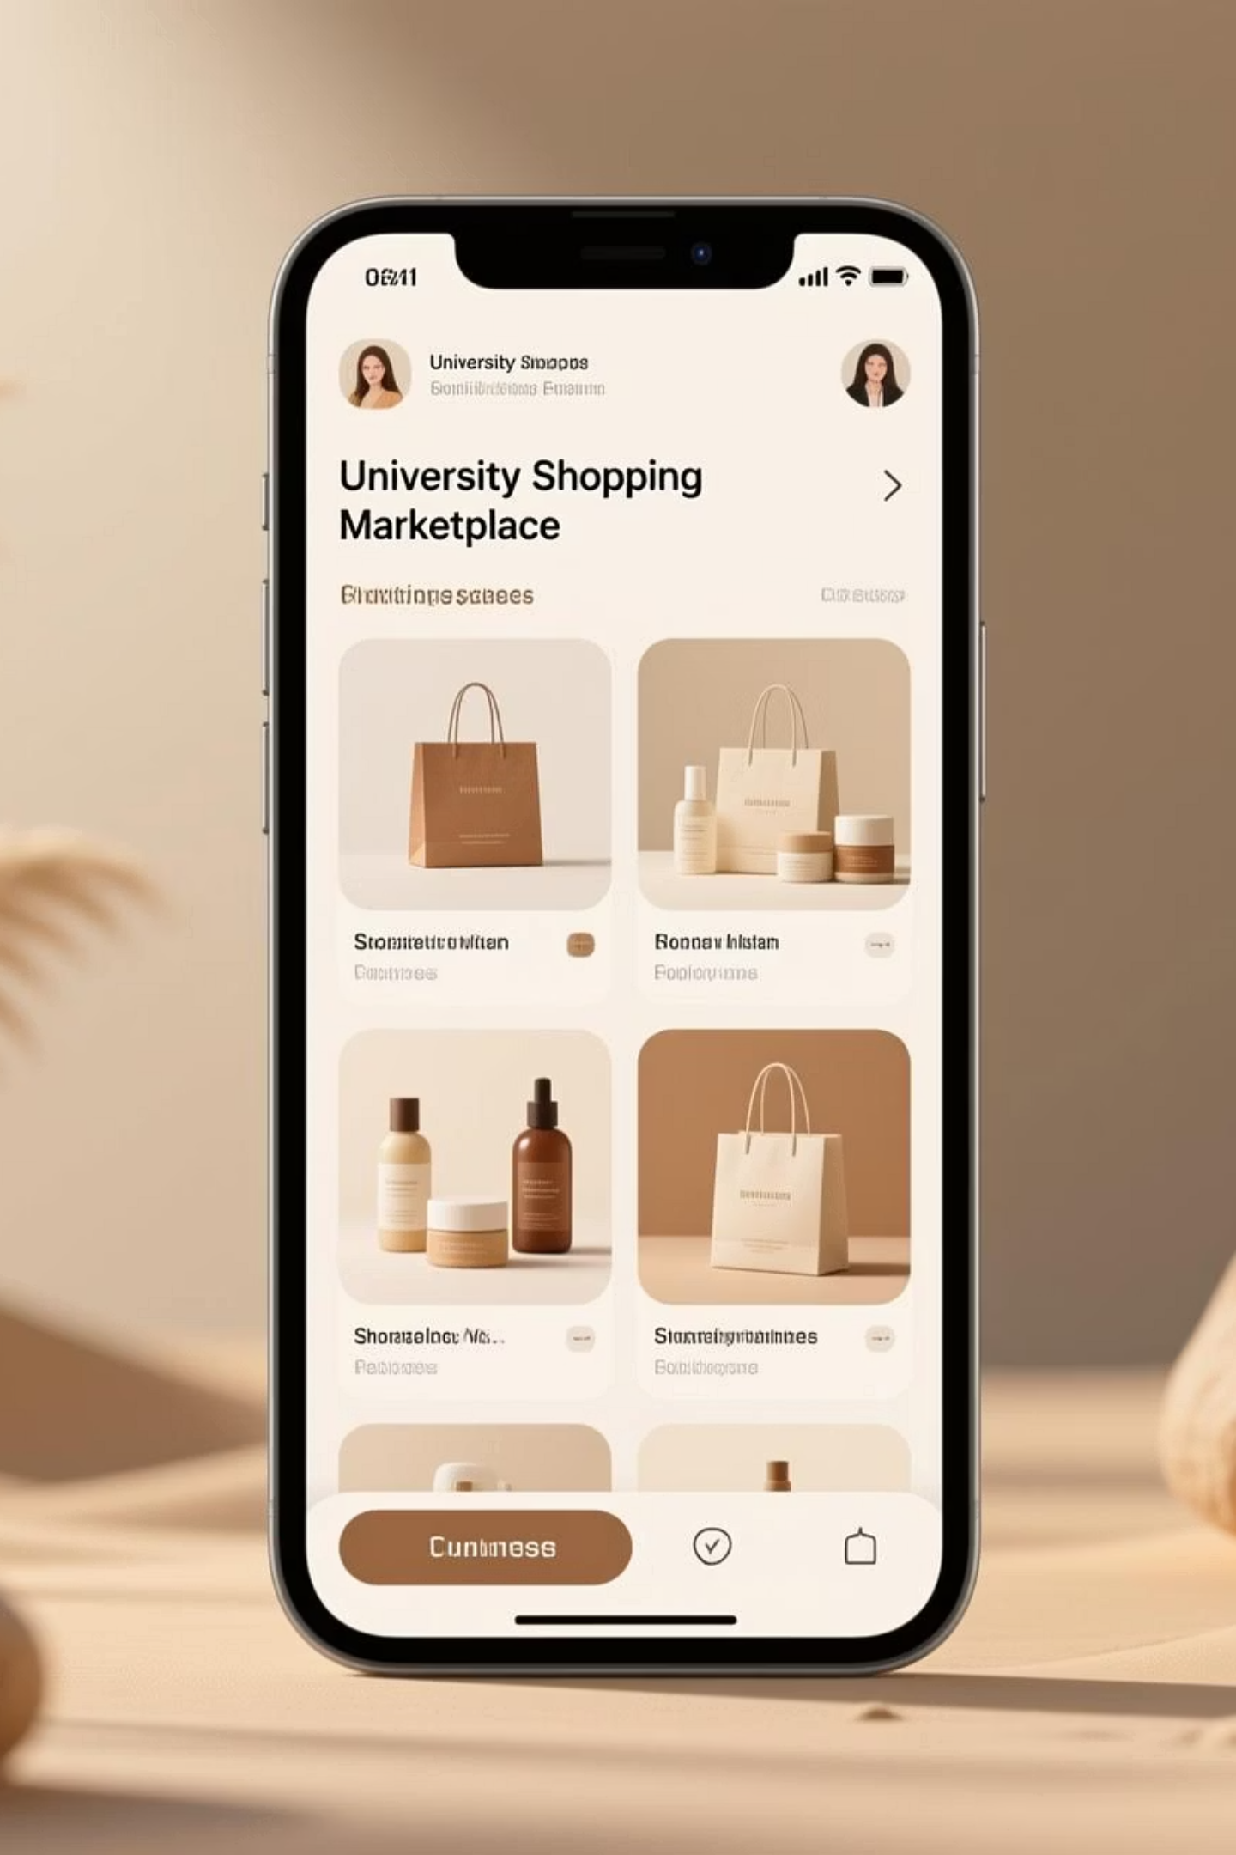
Our Solution: A Unified University Marketplace
We propose an intuitive and secure online marketplace tailored specifically for the university ecosystem.
Tailored Platform
Seamless Commerce
An online marketplace exclusively designed for university students and approved campus vendors.
Features include secure authentication, easy product listing, efficient ordering, and integrated payment solutions.
End-to-End Experience
Comprehensive delivery options and built-in communication tools to streamline transactions.

Slide 4

Project Objectives: Enhancing Campus Commerce
01
Unified Platform
To create a single, accessible platform that connects both buyers and sellers within the university community.
02
Intuitive User Interface
Develop a simple and user-friendly interface for effortless browsing, product listing, and purchasing.
03
Expedited Processing
Ensure fast order processing, with immediate SMS and email confirmations for all transactions.
04
Secure Payments
Implement robust and secure online payment gateways for peace of mind and reliable transactions.

Slide 5

Our Robust Technology Stack
Frontend Excellence
Secure Authentication
ReactJS: Dynamic user interfaces.
JWT: Token-based security.
Redux: Predictable state management.
OTP / Email Verification: Multi-factor user authentication.
Tailwind CSS / Material UI: Modern, responsive design.
Deployment & Services
Render / Vercel / Cloud: Reliable hosting solutions.
Backend Power
Node.js: Scalable server-side applications.
Twilio SMS: Real-time notifications.
Express.js: Robust API development.
Nodemailer: Email delivery services.
Data Persistence
Razorpay / Stripe: Integrated payment gateways.
MongoDB: Flexible, NoSQL database.

Slide 6

System Architecture Overview
A high-level view of how our University Marketplace operates, ensuring secure and efficient interactions.
Payment Gateway
Client
User-facing application
External transaction processor
Authentication Service
University Marketplace Data Flow
API Layer
Handles requests and routing
External identity provider
Database
Server
Persistent data storage
Business logic and processing
This architecture ensures a smooth data flow, robust security measures, and efficient handling of all user requests and transactions.

Slide 7






Key Features: Empowering Campus Trade
Secure Access
Localized Marketplace
Robust Login and Signup with OTP/Email verification for enhanced security.
University-specific marketplaces tailored to campus communities.
Vendor Tools
Seamless Shopping
Comprehensive product management (Add, Edit, Delete) for vendors.
Intuitive Cart and Checkout process for buyers.
Integrated Payments
Order Visibility
Secure online payment options for all transactions.
Real-time order tracking and personalized profile dashboards.

Slide 8
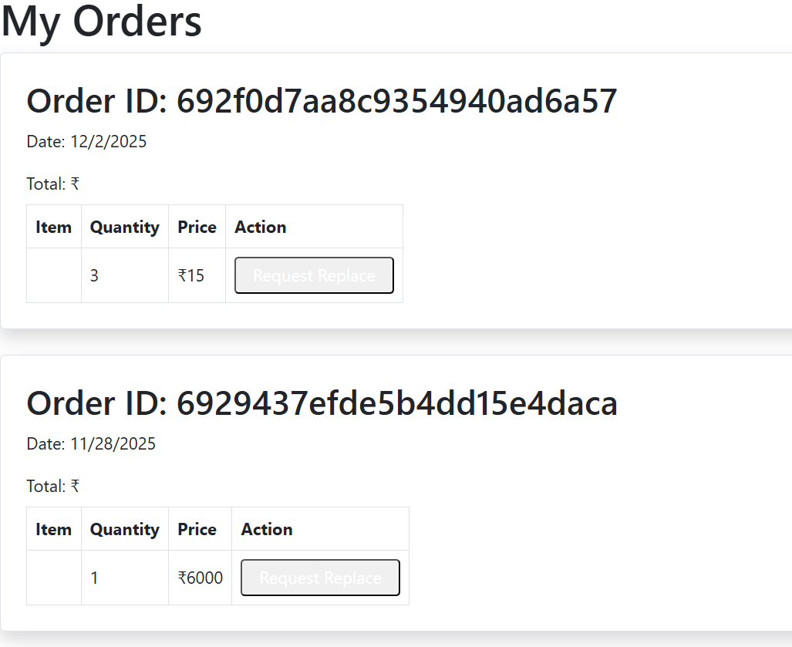
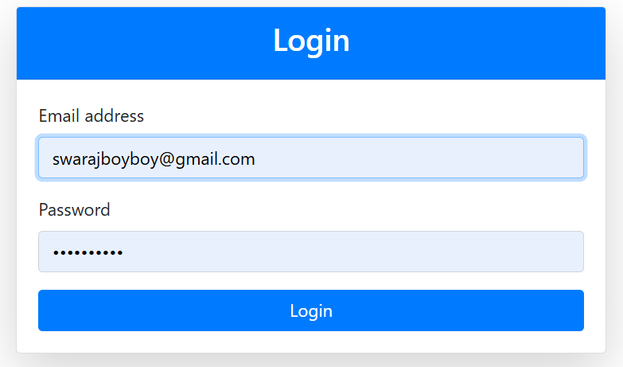
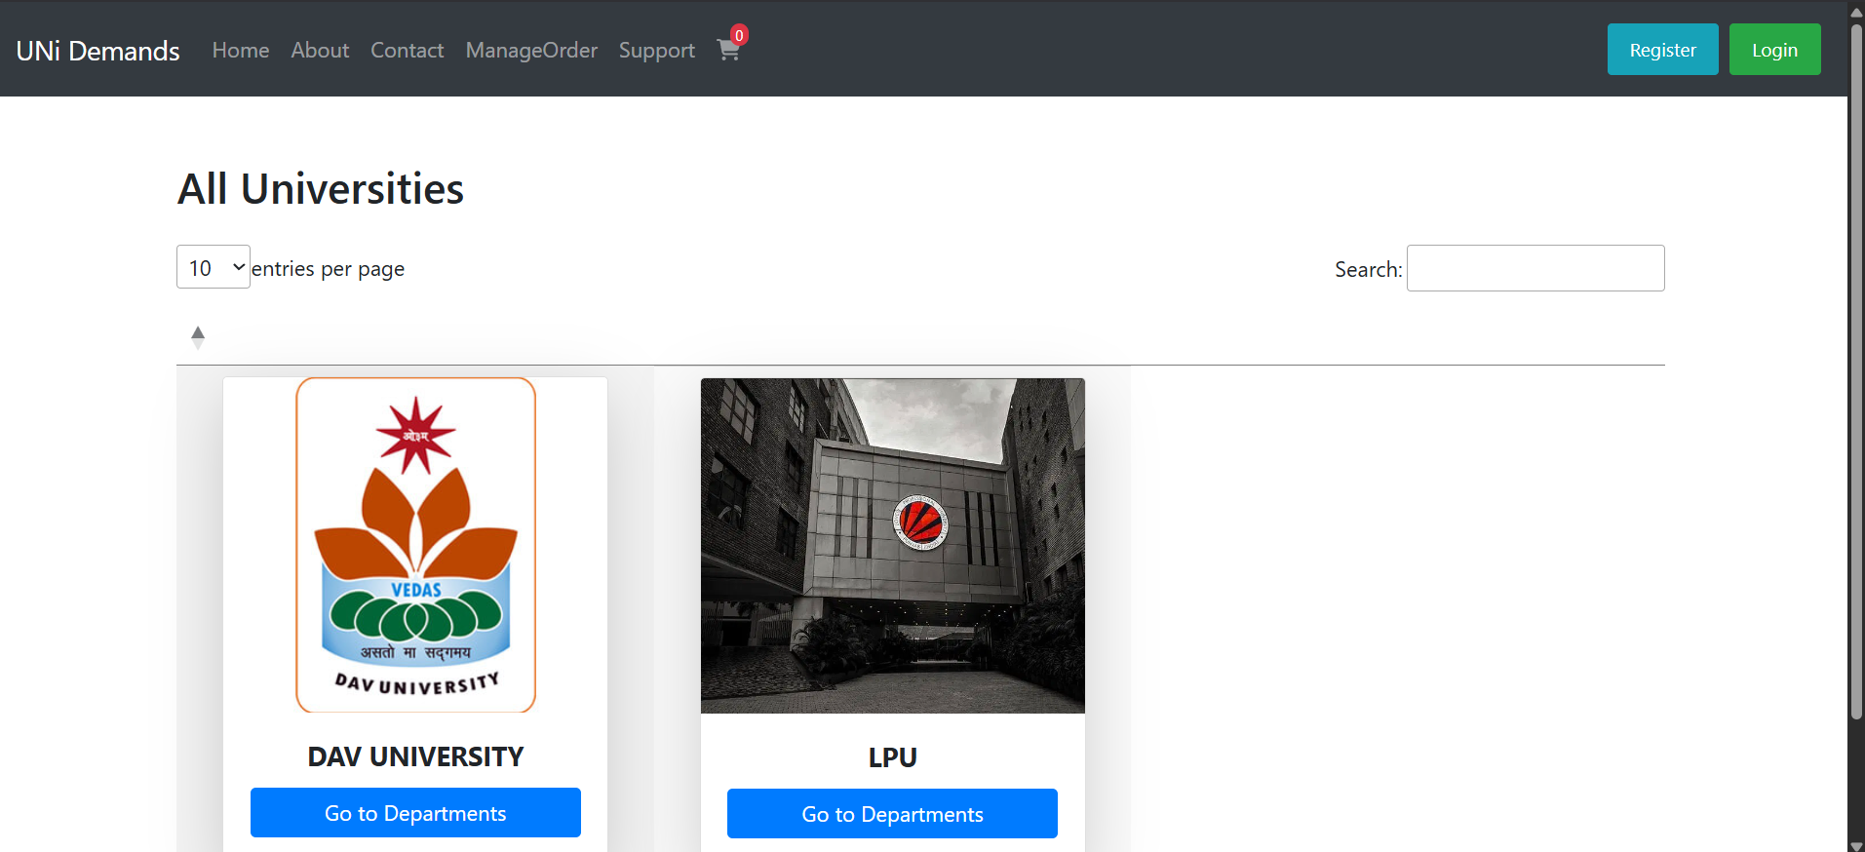
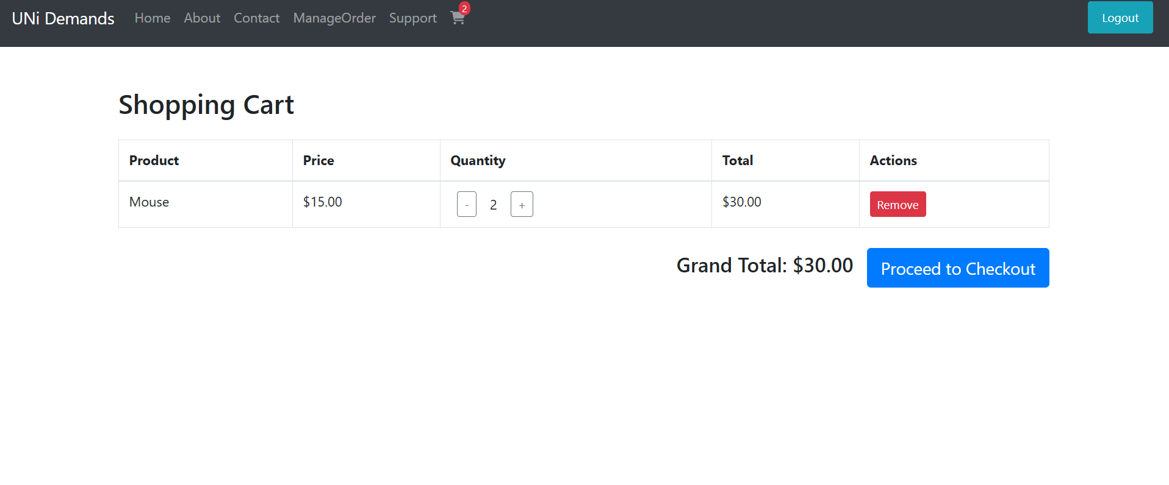
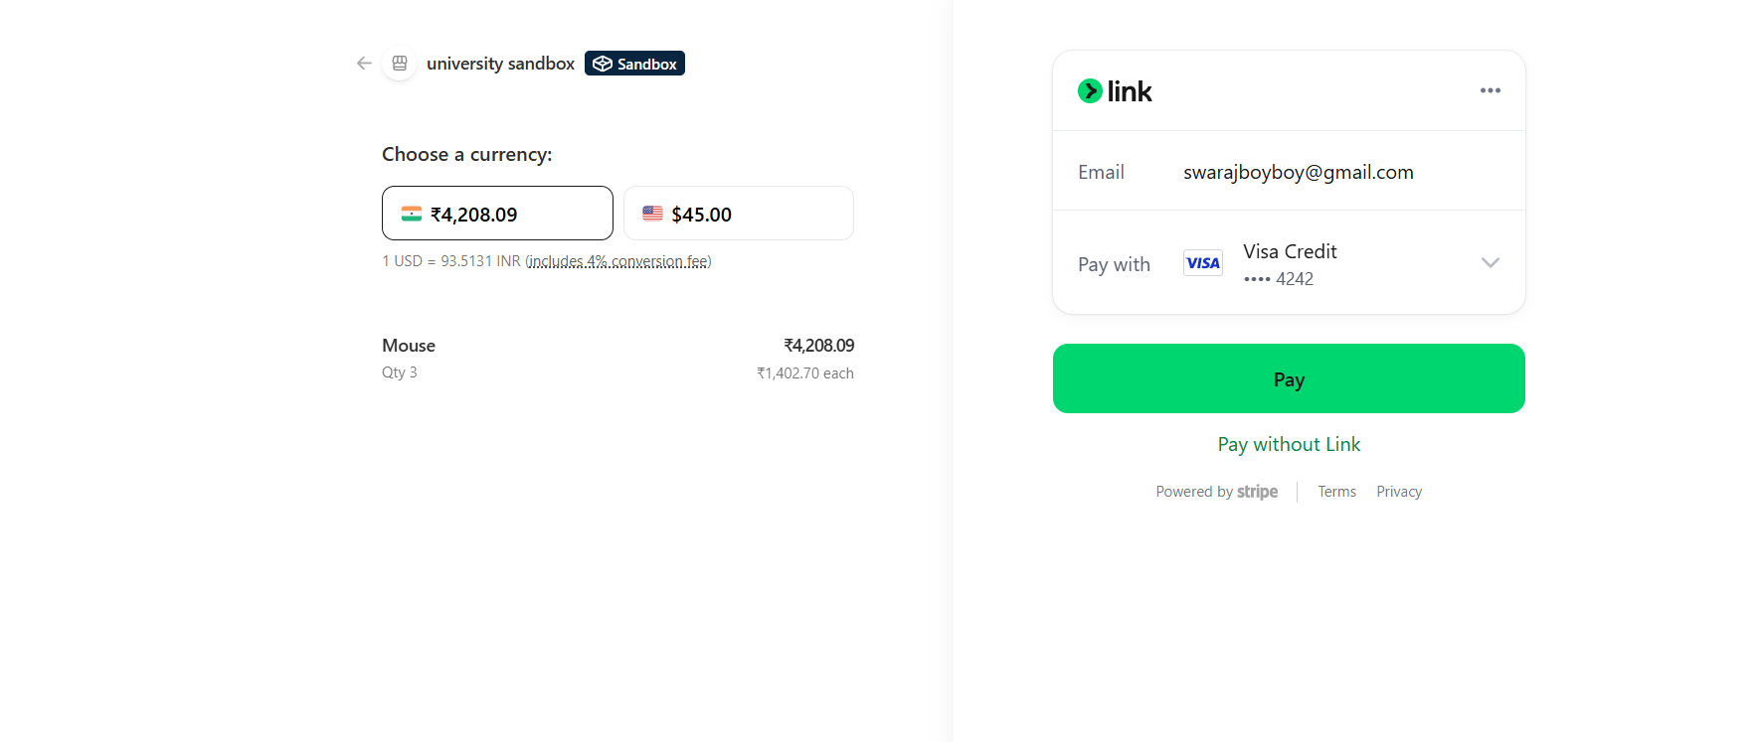
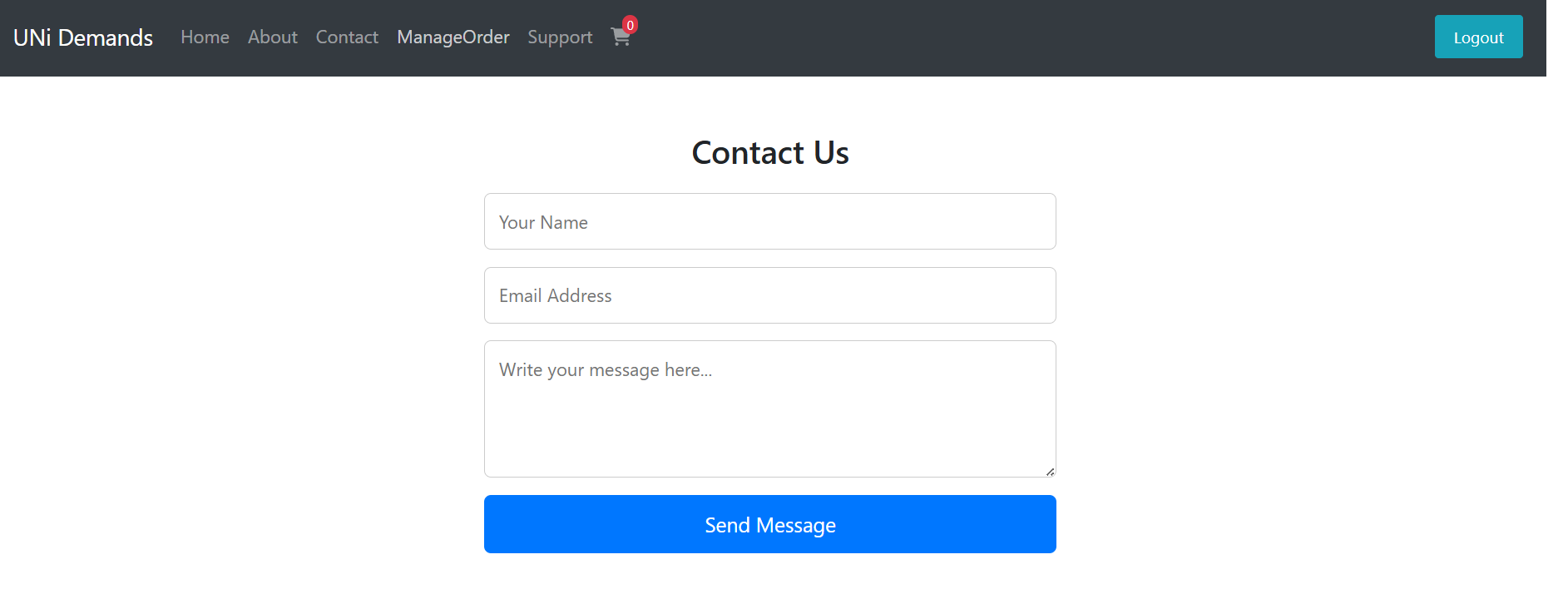
Visualizing the Platform: Key Screenshots
A glimpse into the user experience and functionality of the University Marketplace.

Slide 9

Testing & Achieved Results
Transaction Success
Consistent successful transaction completion rates demonstrate system reliability.
High Performance
Achieved high performance and low latency for all API responses under various load conditions.
Real-Time Alerts
Implemented and verified real-time email and SMS alerts for order updates and confirmations.
Efficiency Boost
Demonstrated significant improvements in buying and selling efficiency for both students and vendors.

Slide 10





Challenges Faced & Lessons Learned
Payment Gateway Integration
Navigating complex APIs and security protocols for seamless payment processing.
Image Handling
Optimizing image upload, storage, and hosting for performance and scalability.
Authentication Security
Implementing robust authentication mechanisms to protect user data and prevent fraud.
Database Optimization
Designing and fine-tuning the MongoDB schema for efficient data retrieval and storage.

Slide 11

Future Scope
01
Mobile App
02
Wallet & reward points
03
AI-based product recommendation
04
Live delivery tracking

Slide 12

Conclusion
Project solves campus commerce problems
Improves efficiency & convenience
Our platform directly addresses the challenges faced by students and vendors in the university community, providing a streamlined solution.
The University Marketplace enhances the overall buying and selling experience through intuitive design, secure processes, and real-time updates.
Ready for real-world deployment
With robust architecture, comprehensive features, and successful testing, the platform is prepared for immediate implementation and impact.

Slide 13
THANK YOU!

